Slide 1
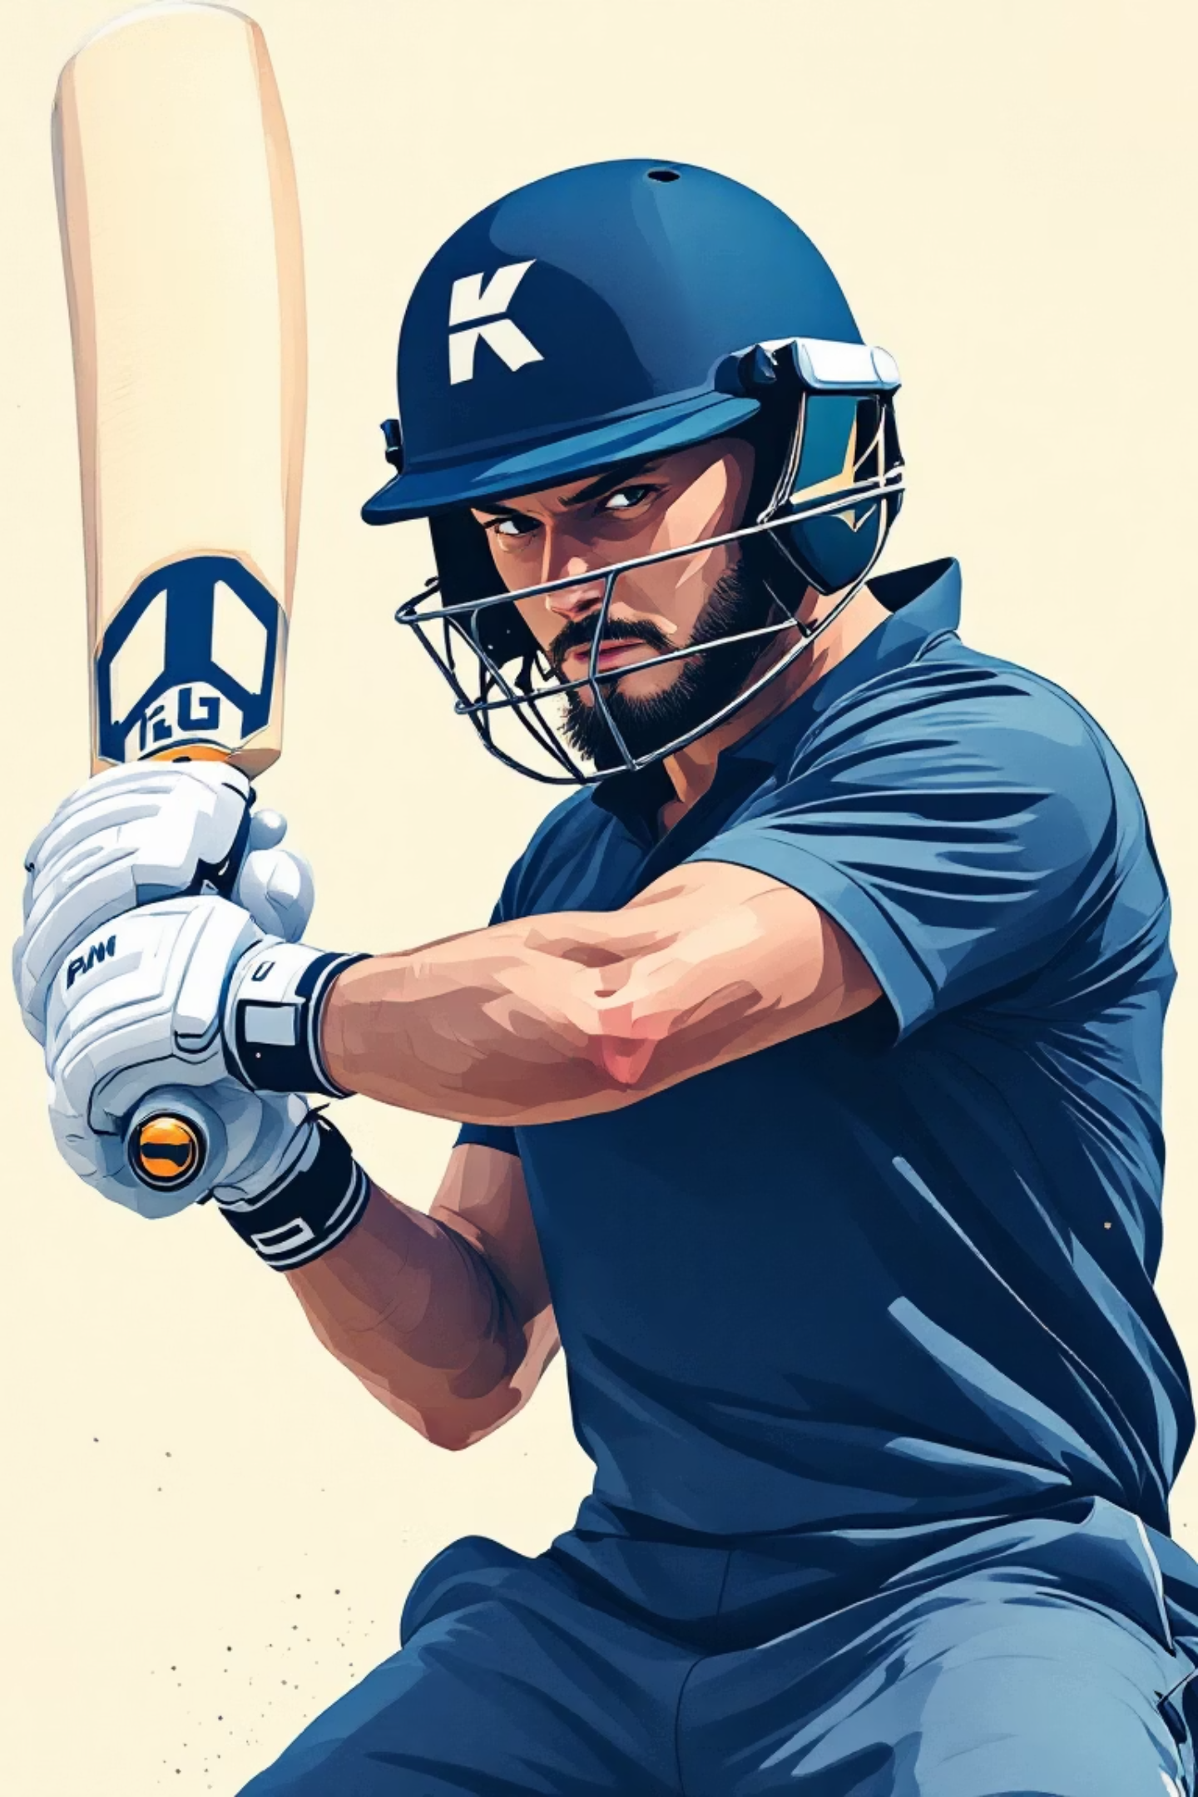
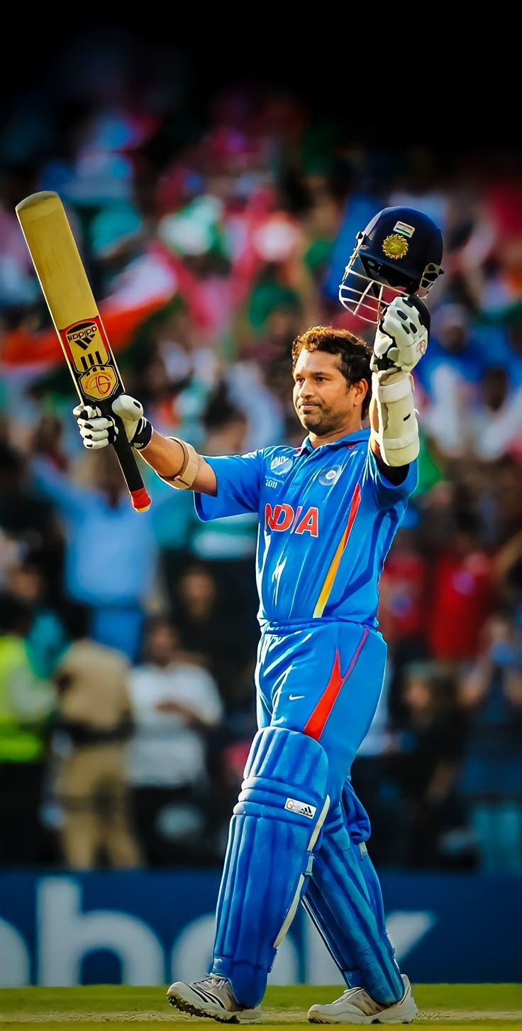

OPK Virtual Batting Coach
Revolutionising cricket training through sensor technology and AI-powered coaching
TEAM MEMBERS
1.MOHAMMED IRFAN.M
2.DINESH KUMAR.M
3.STEFFIN RAJ
4.SHAROFFIN
5.JEEVANANTHAM.T

Slide 2
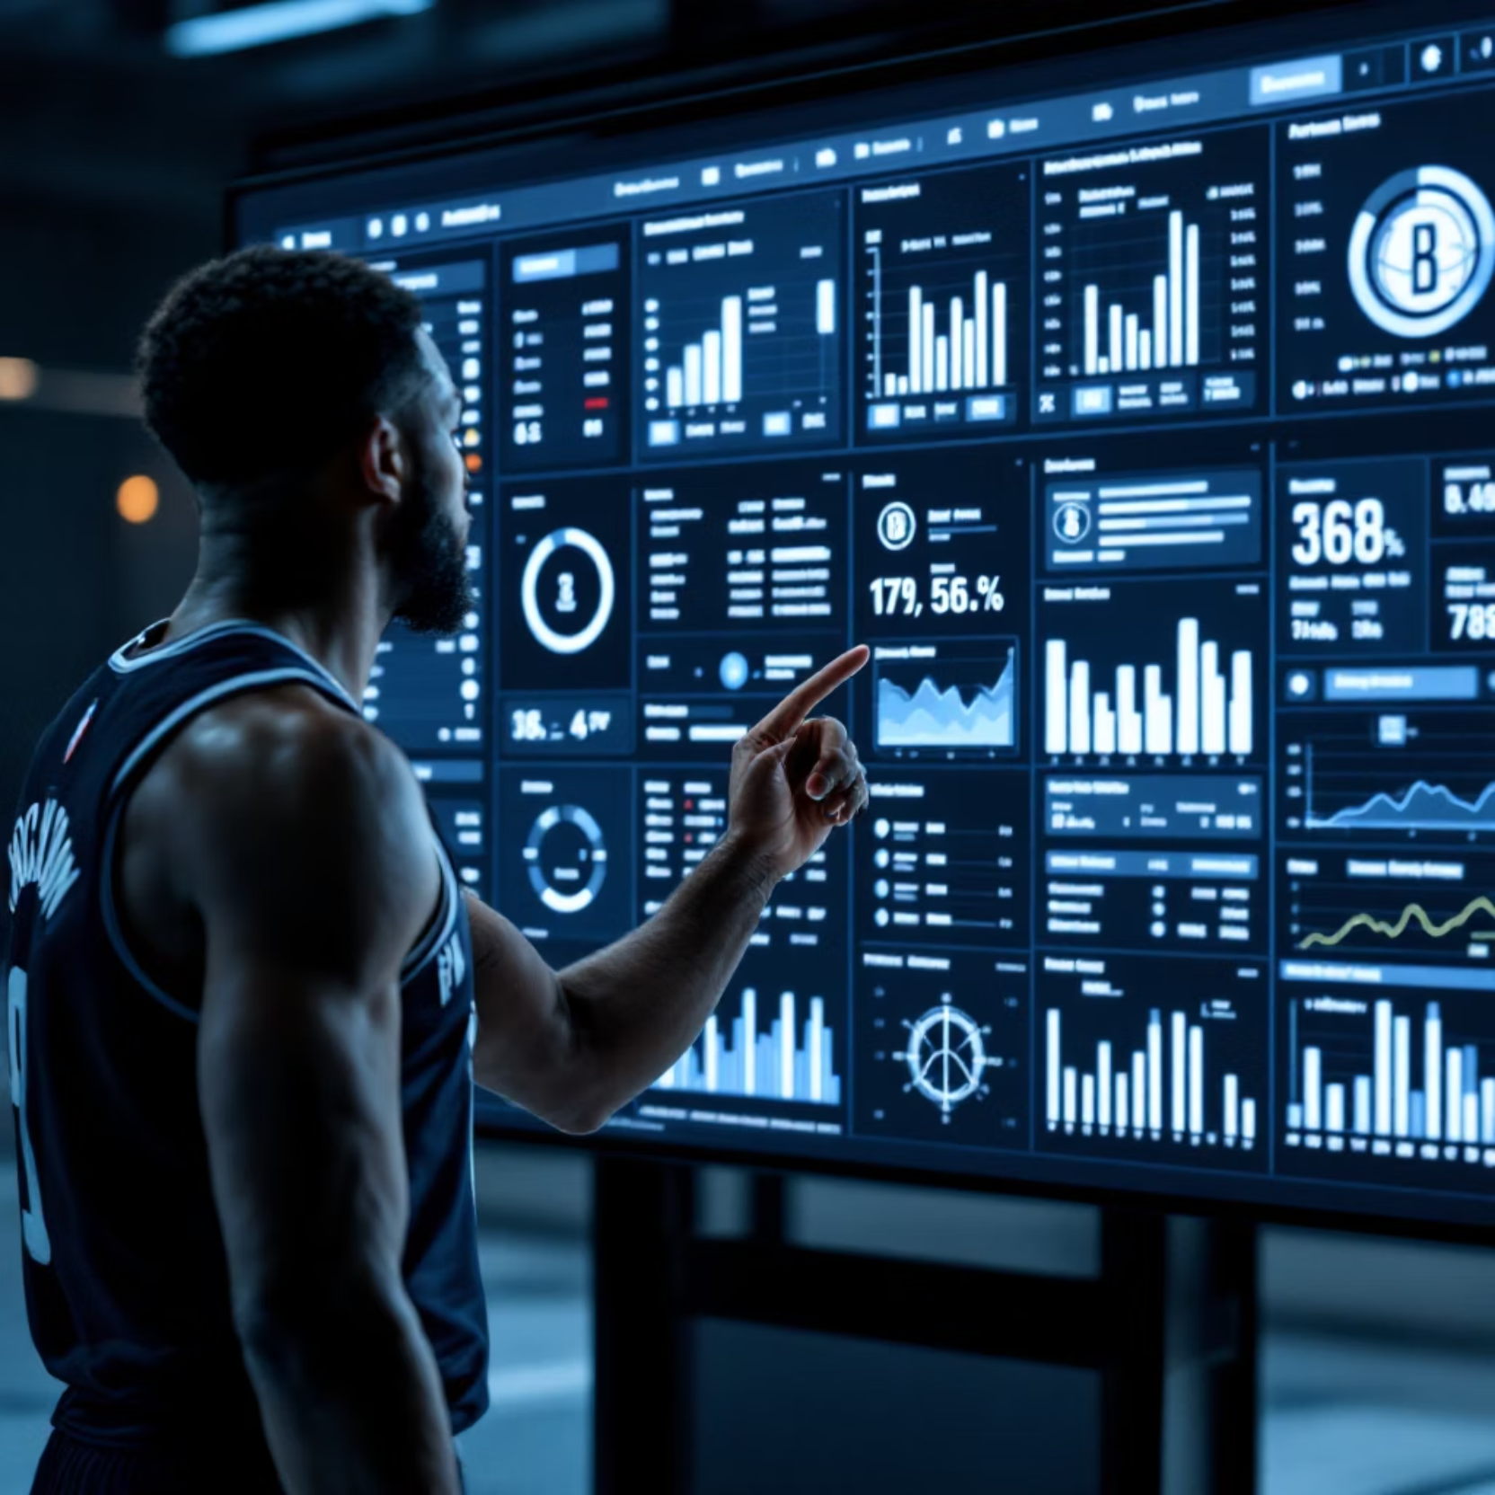
Data Without Insights
1.Current sensor-based cricket bats only collect raw data like speed, angle, and vibration. Players, especially beginners, struggle to interpret this information for meaningful technique improvement.
2.Quality coaching remains expensive and limited at grassroots levels, leaving aspiring cricketers without proper guidance for skill development.

Slide 3




Our Solution: AI-Powered Cricket Mentorship
Smart Sensors
Capture comprehensive swing and impact data
IoT Connectivity
Real-time data transmission via ESP32
AI Analysis
Intelligent interpretation of batting technique
Personalised Coaching
Human-like feedback and actionable recommendations

Slide 4
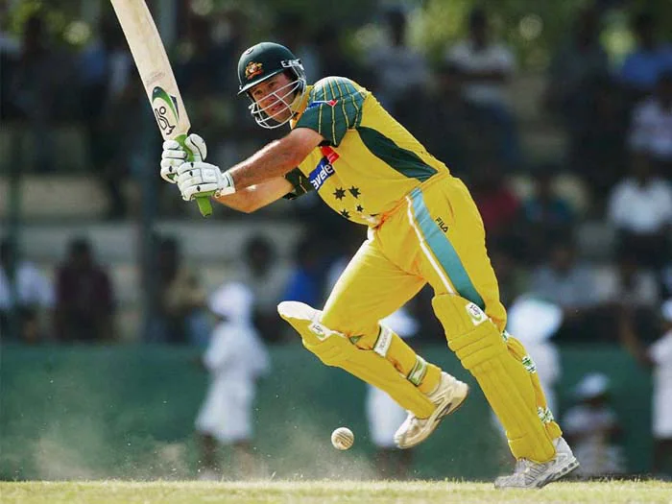
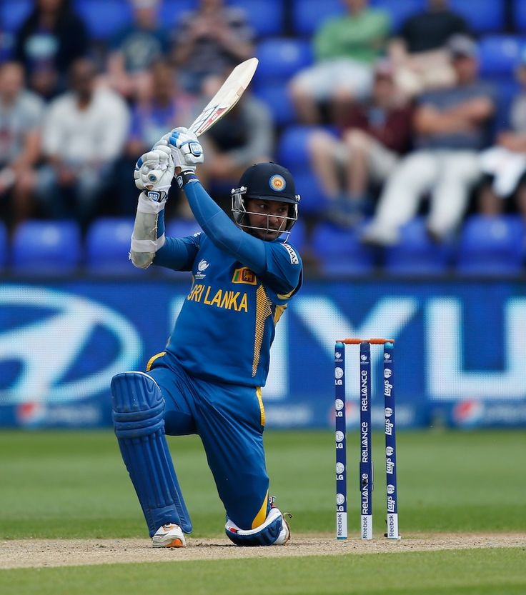
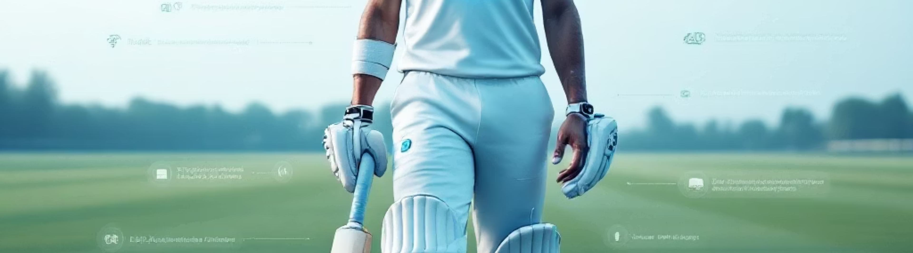
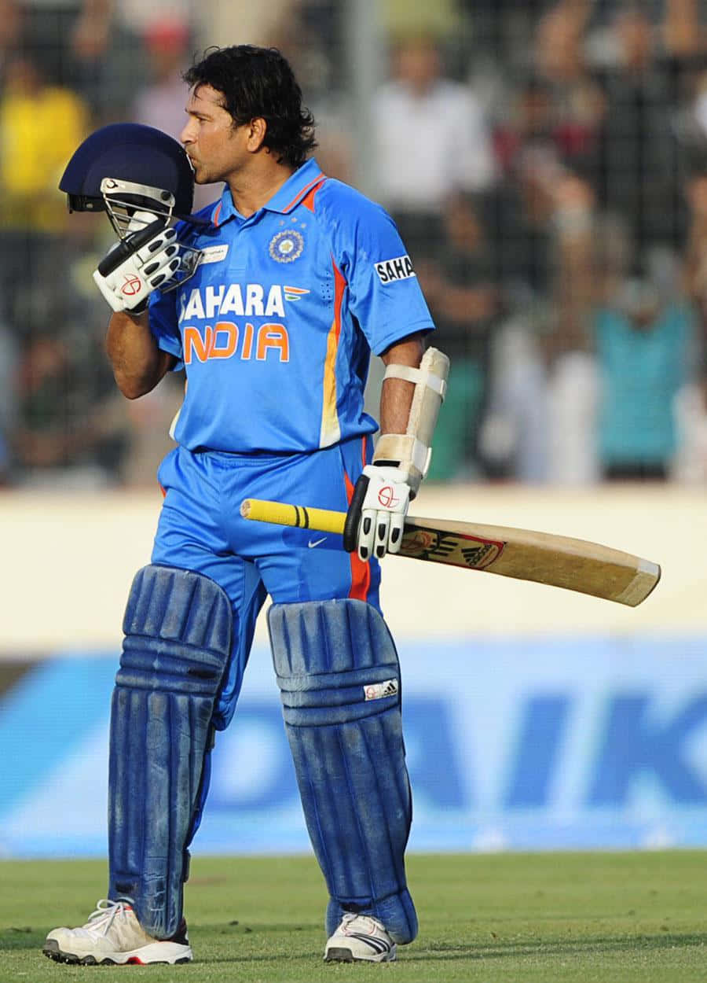
Innovation
Beyond Measurement
Complete Integration
Gamified Learning
First AI mentor that interprets, coaches, and predicts batting performance improvements
Combines IoT sensors, machine learning, and recommendation AI in cricket training
Makes practice engaging through interactive challenges and progress tracking

Slide 5
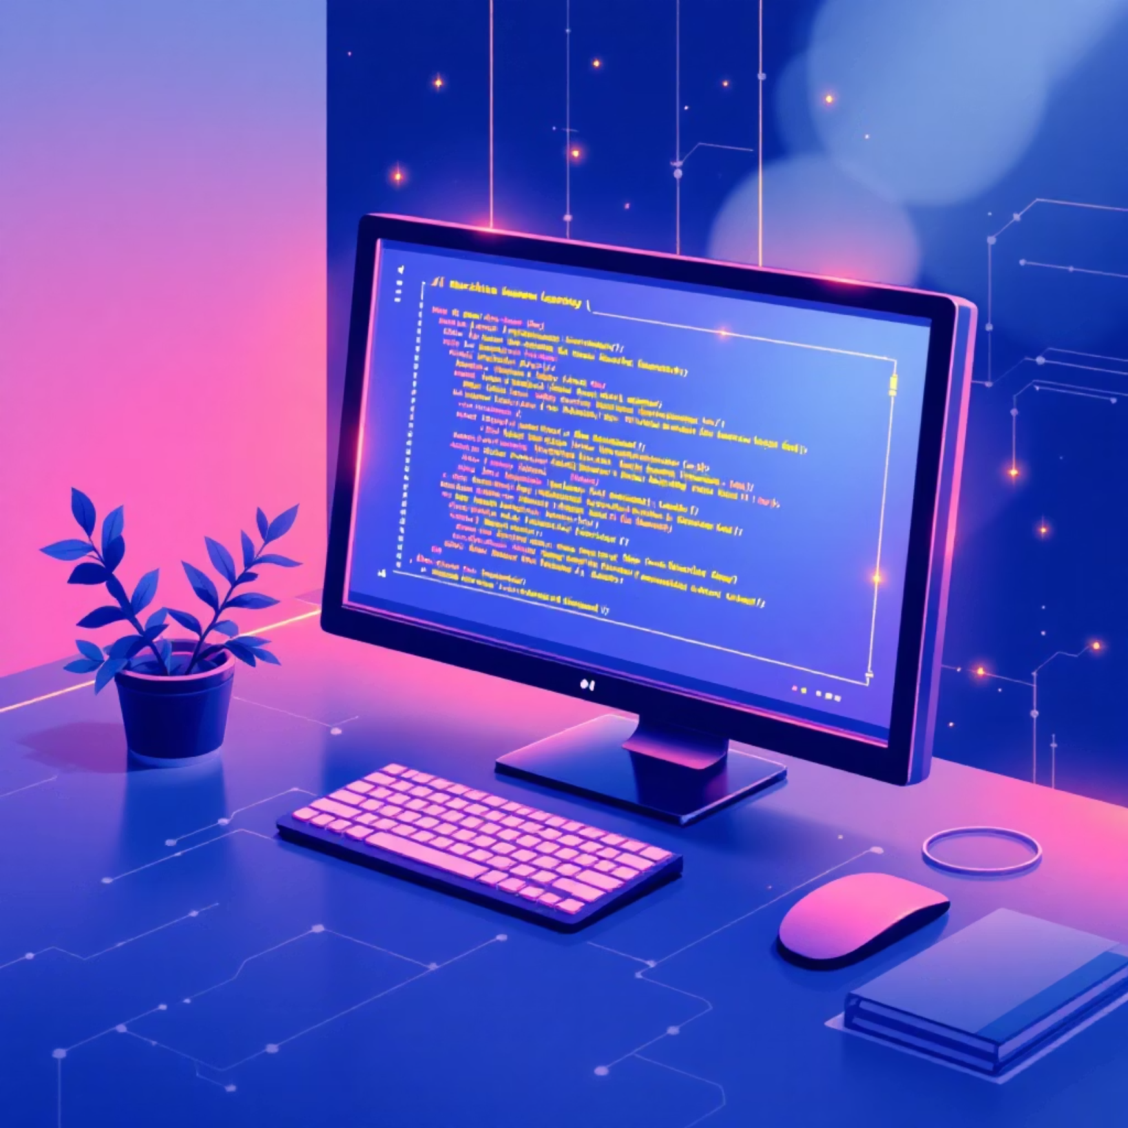
Technology Stack
Hardware & Connectivity
AI & Software
ESP32 microcontroller with Wi-Fi/Bluetooth
TensorFlow/PyTorch for ML models
MPU6050 motion sensor (±16g, ±2000°/s)
Shot timing classification algorithms
High-sensitivity impact sensors
Swing pattern recognition system
Low-cost, widely available components
Flutter/React Native mobile app

Slide 6
Workflow Process
01
02
03
Data Capture
Wireless Transmission
AI Analysis
Sensors record bat swing dynamics and ball impact data in real-time
ESP32 board sends data via Bluetooth/Wi-Fi to processing unit
Machine learning models classify shots and detect timing errors instantly
04
05
Smart Recommendations
Visual Feedback
AI generates personalised coaching tips, corrections, and training drills
Players receive insights through intuitive app interface with graphs and scores

Slide 7
Overcoming Key Challenges
Limited Training Data
Real-Time Performance
Cost Accessibility
Challenge: Small datasets for AI model training
Challenge: Need for instant feedback delivery
Challenge: Keeping solution affordable for grassroots players
Solution: Start with synthetic data, expand with real practice sessions
Solution: Edge computing on ESP32 and mobile devices
Solution: Open-source models with low-cost IoT hardware

Slide 8
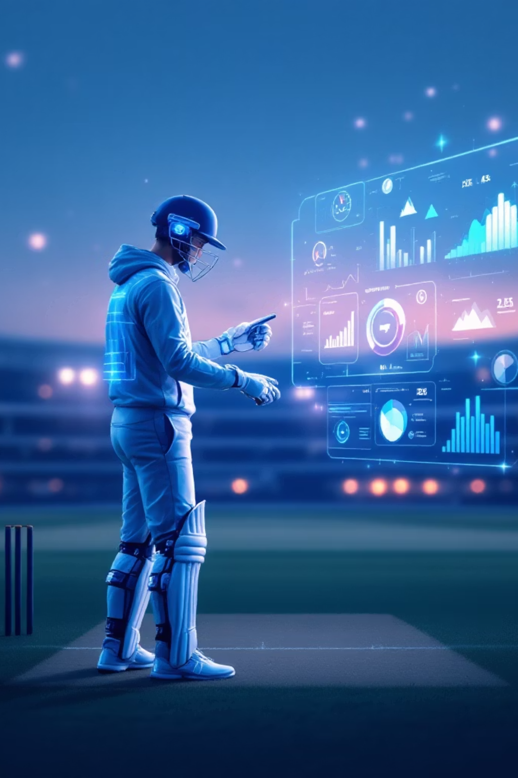



Transformative Impact
Democratised Coaching
Makes world-class cricket mentorship accessible to players regardless of location or economic background
Independent Training
Enables self-directed skill development with AI-driven insights and personalised improvement plans
Enhanced Coaching
Provides coaches with data-driven insights for more effective training methodologies

Slide 9


Market Opportunity & Competitive Advantage
The sports-tech industry is experiencing rapid growth, particularly in cricket-heavy markets like India, UK, and Australia. Amateur players and training academies represent a massive underserved market.
Current solutions like SmartBat and Str8bat focus only on data visualisation. Our AI coaching platform offers affordable, personalised mentorship that no competitor currently provides.
Unique Value: "Not just data, but a digital cricket coach in your pocket"

Slide 10
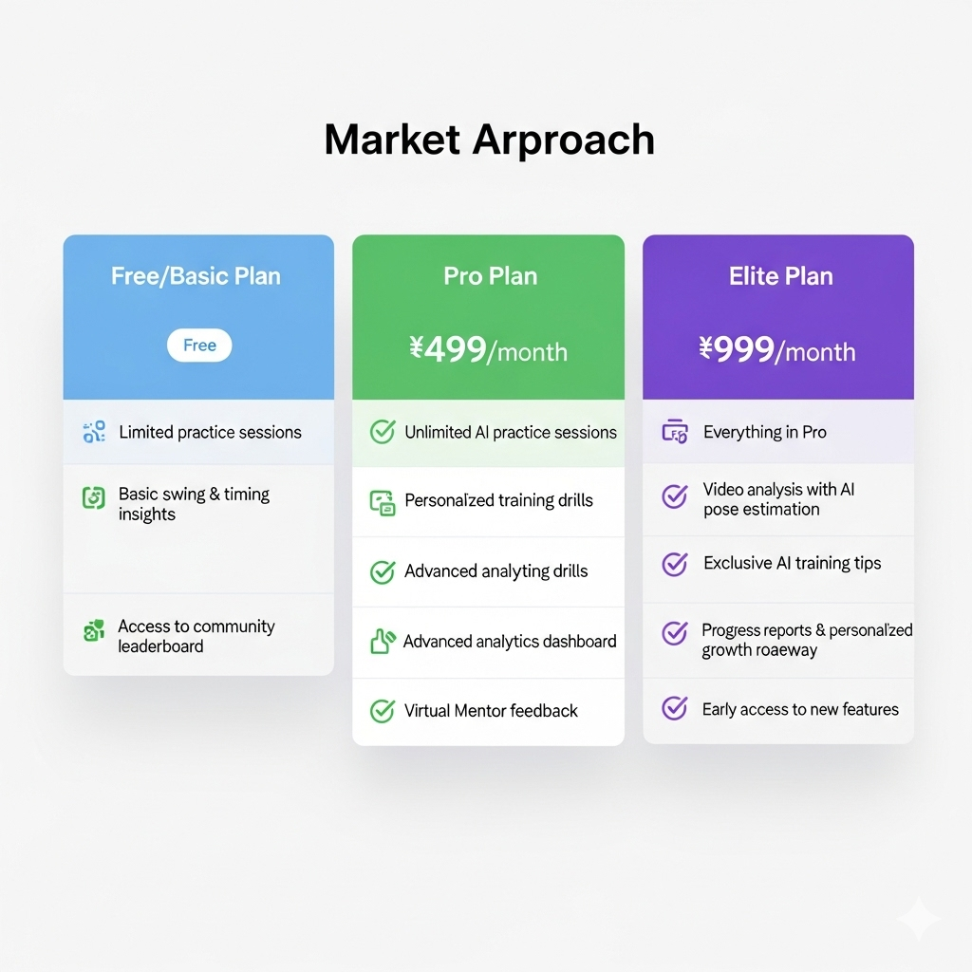

Slide 11
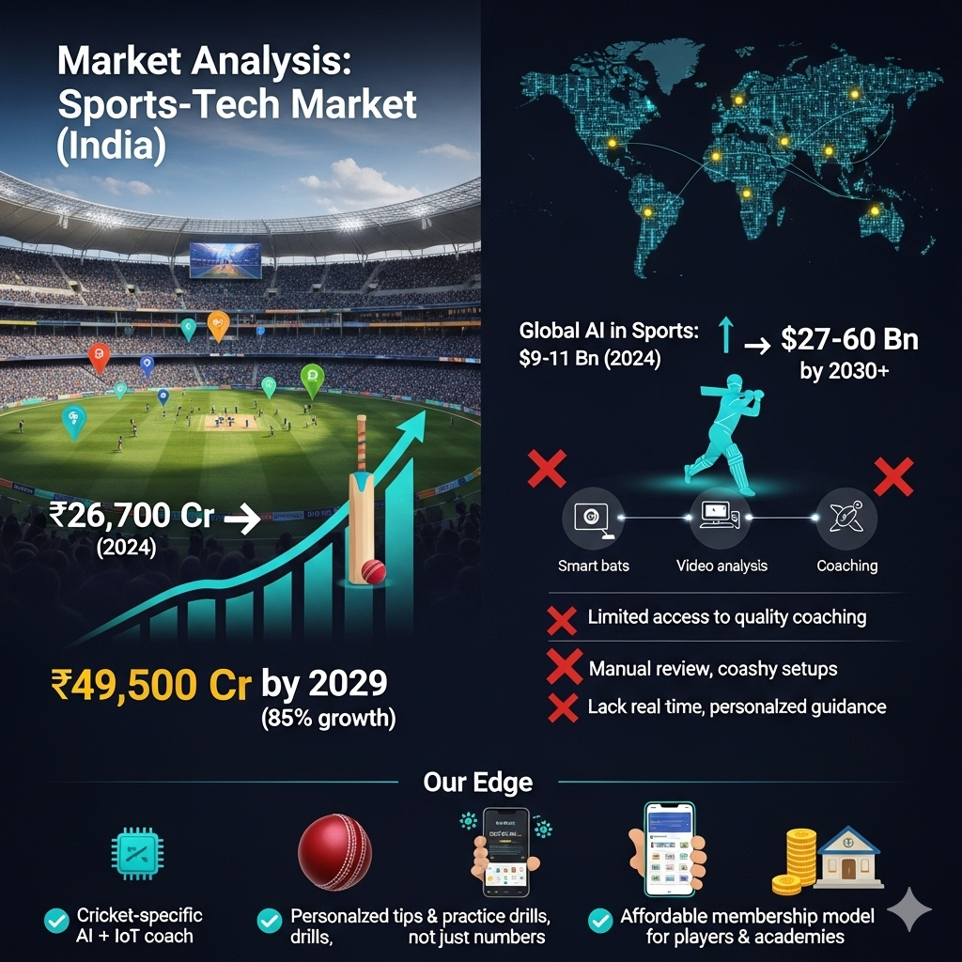

Slide 12
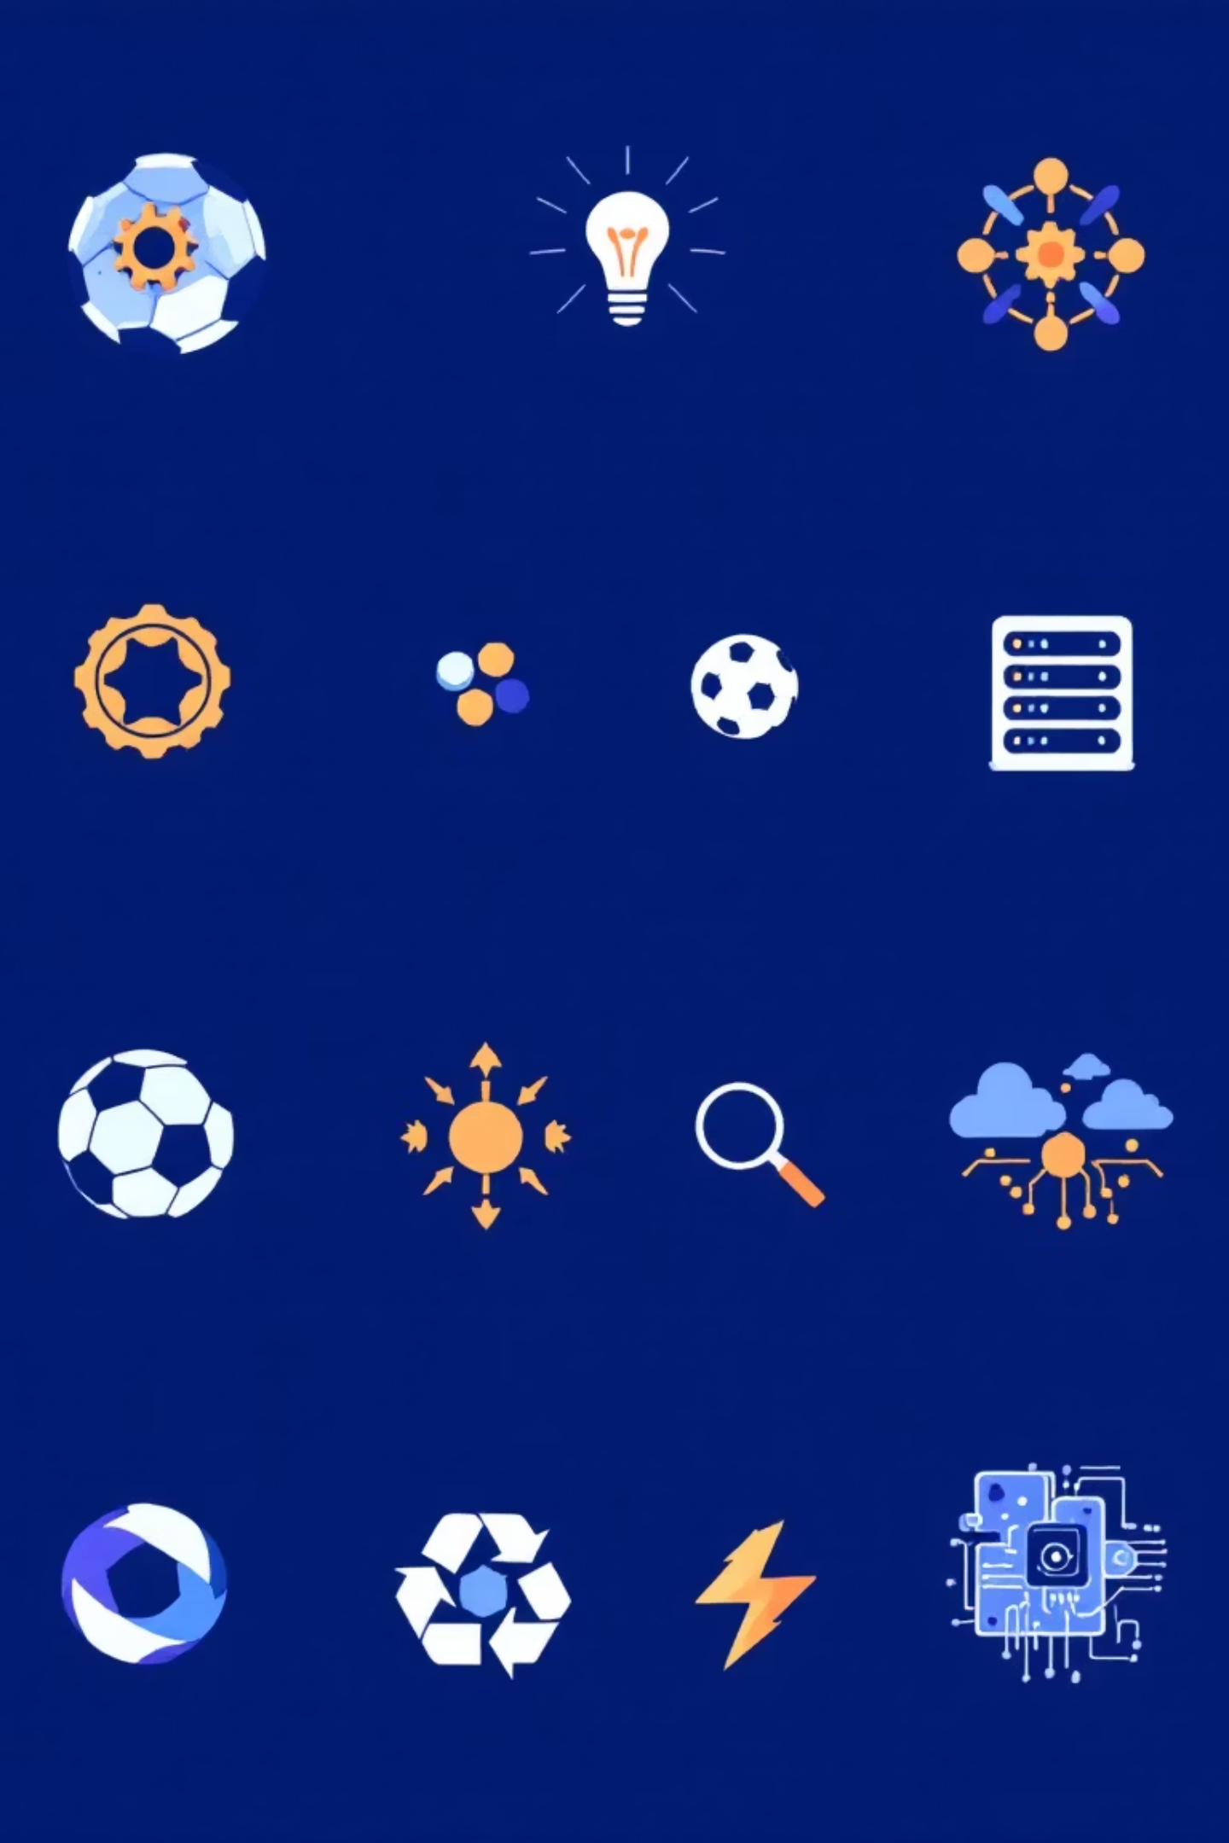
Future Vision
1
Phase 1: Core Platform
Launch AI batting coach with sensor integration and mobile app
2
Phase 2: Advanced AI
Add pose estimation, digital twin technology, and injury prevention
3
Phase 3: Global Expansion
Community benchmarking, AR/VR integration, multi-sport platform
Supporting UN SDGs: Good Health & Well-being, Quality Education, Innovation, and Reduced Inequalities through accessible sports technology.

